Slide 1
Object Orientation Design
Lecture 01: Introduction

Slide 2
Object Oriented Analysis and Design
Lecturer: Ms. Sulochana Rupasinghe (sulochana.r@iit.ac.lk)
Module Leader: Mr. Saman Hettiarachchi (saman.h@iit.ac.lk)
Theory + Practical: 2 Hours
Tools: StarUML, Draw.IO, Lucidchart

Slide 3
Module Content
Week 1: Introduction to OOAD
Week 2: Use Case Diagram
Week 3: Use Case Descriptions
Week 4: Activity Diagram
Week 5: Domain Models
Week 6: Student Engagement Week
Week 7: Class Diagrams – Part 1
Week 8: Class Diagrams – Part 2
Week 9: Sequence Diagram
Week 10: State Machine Diagram
Week 11: SOLID Principles and Design Patterns

Slide 4
Lecture Plan

Slide 5
What is OOAD ??
Object-oriented analysis and design (OOAD) is a software engineering approach that models a system as a group of interacting objects.
Each object represents some entity of interest in the system being modeled, and is characterized by its class, its state (data elements), and its behavior.
Various models can be created to show the static structure, dynamic behavior, and run-time deployment of these collaborating objects.
There are a number of different notations for representing these models, such as the Unified Modeling Language (UML).
OOA focuses on what the system does, OOD on how the system does it.

Slide 6
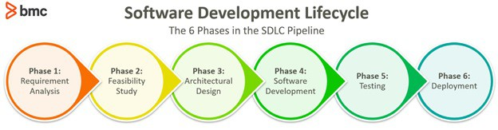
Software Development Life Cycle

Slide 7
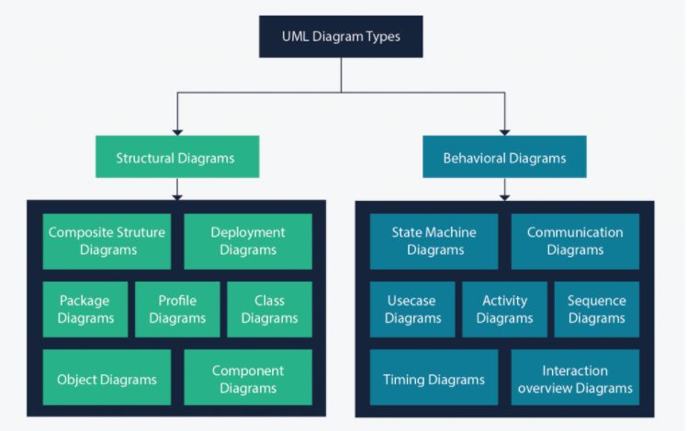
Unified Modeling Language (UML)

Slide 8
UML Diagrams
Structure diagrams show the things in the modeled system. In a more technical term, they show different objects in a system.
Behavioral diagrams show what should happen in a system. They describe how the objects interact with each other to create a functioning system.

Slide 9
Class Diagram
The main building block of any object oriented solution.
It shows the classes in a system, attributes, and operations of each class and the relationship between each class.
In a large system with many related classes, classes are grouped together to create class diagrams.
Different relationships between classes are shown by different types of arrows.
Class Name
Attributes
Methods

Slide 10
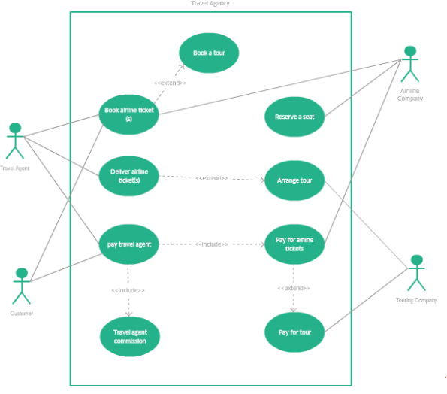
Use Case Diagram
A use case diagram is the primary form of system/software requirements for a new software program underdeveloped.
Use cases specify the expected behavior (what), and not the exact method of making it happen (how).
Use cases once specified can be denoted both textual and visual representation.
A key concept of use case modeling is that it helps us design a system from the end user's perspective. It is an effective technique for communicating system behavior in the user's terms by specifying all externally visible system behavior.

Slide 11
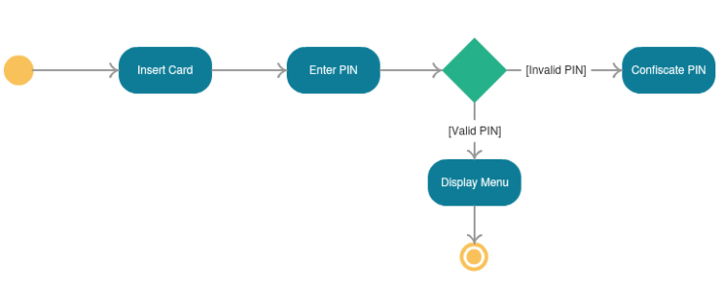
Activity Diagram
Activity diagram is basically a flowchart to represent the flow from one activity to another activity. The activity can be described as an operation of the system.
The control flow is drawn from one operation to another. This flow can be sequential, branched, or concurrent. Activity diagrams deal with all type of flow control by using different elements such as fork, join, etc.

Slide 12
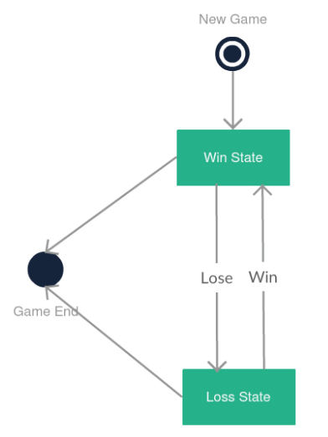
State Machine Diagram
It describes different states of a component in a system. The states are specific to a component/object of a system.
Statechart diagram describes the flow of control from one state to another state.
States are defined as a condition in which an object exists and it changes when some event is triggered.
The most important purpose of Statechart diagram is to model lifetime of an object from creation to termination.
Statechart diagrams are also used for forward and reverse engineering of a system.

Slide 13
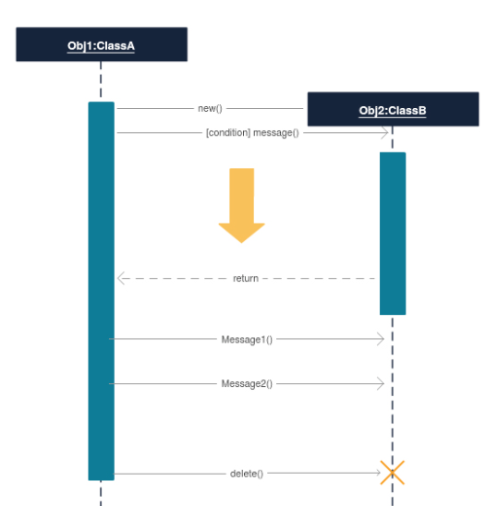
Sequence Diagram
Sequence diagram shows how objects interact with each other and the order those interactions occur.
It’s important to note that they show the interactions for a particular scenario. The processes are represented vertically and interactions are shown as arrows.

Slide 14
References
creately. 2021. UML Diagram Types Guide: Learn About All Types of UML Diagrams with Examples. [online] Available at: <https://creately.com/blog/diagrams/uml-diagram-types-examples/#ClassDiagram> [Accessed 26 September 2021].

